Slide 1
ALGORITHM FOR MATHEMATICAL SIMPLICATION
BATCH NO:10
Satyam Sharma (160717733061)
L. Sai Prakash(160717733062)
K. Dhanush Reddy (160717733106)
Under the guidance of
Dr R Ch A Naidu
Professor, CSE
Project coordinators:
Dr B Jayalakshmi
Associate Professor, CSE
K Uday Kumar
Assistant Professor, CSE

Slide 2
Abstract
Solving complex mathematical equations is both time consuming and mostly inaccurate when done manually.
The main aim of this project is to develop an algorithm which makes Mathematical Simplification of complex equations.
It provides user the flexibility to choose an method.
It provides very speed computation for any complex equations

Slide 3
Introduction
“Algorithm For Mathematical Simplification” is a algorithm designed for helping the user to solve complex mathematical equations without doing them manually .
The algorithm mainly build with the vision of providing an easy mathematical simplification approach with peak accuracy.
The algorithm also provides the user the flexibility to apply multiple methods at the same time , thus giving an user the smart way to choose the best method for the given equation.

Slide 4
Existing system
In existing system, solving mathematical equations are done manually.
Solving the mathematical equations are complex and time consuming .
Solving a number of Mathematical methods becomes complex , inaccurate.
Selecting an appropriate method for an mathematical simplification of a particular equation consumes a lot of time and energy of an user with no guaranteed accurate outcome resulting in false predictions.

Slide 5
Proposed system
User friendly interface
Less error
Peak accuracy
Fast access to methods
Quick simplification
More storage capacity

Slide 6
start
Enter a,b
Enter eps.
Is f(a)*
f(b)<0
NO
Is |ab|<eps?
NO
c=(a+b)/2
NO
Is f(a)*f(c)<0?
a=c
b=c
Print c
End

Slide 7
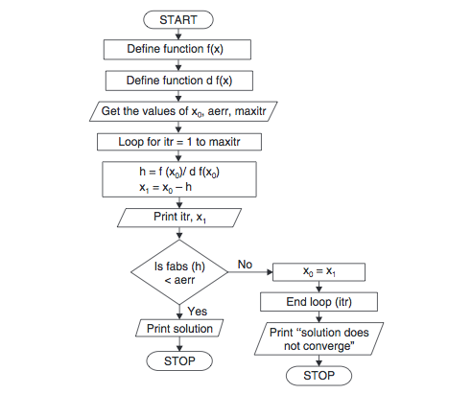

Slide 8
Start
Enter the no of data points:
NO
yes
Enter the y data points:
NO
yes
Enter value of x for interpolated y(x):
NO
yes
The interpolated value is :
End

Slide 9
Start
Enter the no of data points:
Enter the y data points:
Enter value of x for interpolated y(x):
The interpolated value is :
End

Slide 10
Start
Enter x
NO
YES
Enter eps:
NO
YES
x_{n}=x-f(x)/f’(x)
YES
Is
(x_{n} –x)<=eps
NO
YES
print c
End

Slide 11
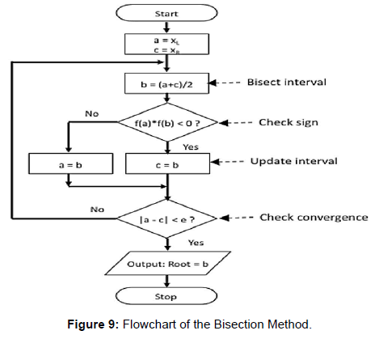

Slide 12
System Requirements
Hardware Requirements
Disk space: 1TB
Memory: 4 GB RAM
Processor: 2.4 GHZ processor speed
Software Requirements
Compiler’s : notepad++ , cpp.sh , onlinegdb.com
Operating System: Windows 7,8,9,10,XP.

Slide 13
THANK YOU

